Slide 1
agenda
Zepto presentation
Introduction
Porter's 5 Forces
PESTLE
SWOT
Six Forces Model
GAP
3 p's
STP
PROFITABILITY FRAMEWORK
Marketing mix model
3 c’s Framework
Product Life Cycle
MECE

Slide 2
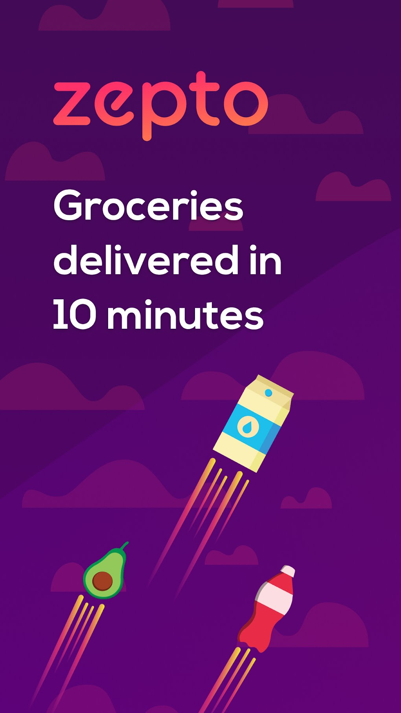
An Analysis of Ultra-Fast Delivery Services
Introduction Zepto is a Indian quick commerce startup that delivers groceries and essentials within10 minutes. Founded in 2021 by Aadit Palicha and Kaivalya Vohra
Business Model
Quick Commerce (Q-commerce): Zepto focuses on delivering groceries and essential items within a short time frame, often targeting 10-minute deliveries. Operates on a hyperlocal delivery model, leveraging a network of micro-warehouses (dark stores).

Slide 3
Revenue Streams:
Delivery fees charged to customers.
Commission from brands and suppliers. Partnerships and advertising.
Competitive Landscape
Other q-commerce players like Swiggy Instamart, Blinkit (formerly Grofers), and Dunzo.
Traditional e-commerce giants like Amazon and Flipkart.

Slide 4
1. Porter's 5 Forces
1.1. Threat of New Entrants
High due to low entry barriers, but significant initial investment in technology and infrastructure may deter some.
1.2. Bargaining Power of Suppliers
Medium as Zepto can negotiate favorable terms with suppliers due to volume but may face competition from larger players.
1.3. Bargaining Power of Customers
High because customers have many alternatives (other q-commerce platforms, traditional e-commerce)

Slide 5
1.4. Threat of substitute products or services
medium to high due to alternatives like traditional grocery shopping, other delivery apps, and meal delivery services.
1.5. Industry Rivalry
High with intense competition from Swiggy Instamart, Blinkit, Dunzo, and others.

Slide 6
2. PESTLE Analysis
2.1. Political
Regulations regarding e-commerce and delivery services.
2.2. Economic
Impact of economic downturns on disposable income and consumer spending on convenience.
2.3. Social
Growing demand for convenience, fast delivery, and online shopping among urban populations.
2.4. Technological
Dependence on advanced logistics, data analytics, and mobile app technology.
2.5. Legal
Compliance with labor laws, consumer protection laws, and data privacy regulations.
2.6. Environmental
Concerns around carbon footprint from delivery logistics and packaging waste.

Slide 7

3. SWOT Analysis
Strengths
Strong technological infrastructure.
Fast delivery promise.
Focus on customer experience.
Weaknesses
High operational costs.
Limited profitability.
Dependence on urban areas.
Opportunities
Expansion into new cities and countries.
Diversification into new product categories.
Partnership opportunities.
Threats
Intense competition.
Regulatory changes.
Market saturation.

Slide 8

Six Forces Model
4.1. Customers
High expectations for speed and service quality.
4.2. Suppliers
Must maintain strong relationships for timely supply of products.
4.3. Competitors
Multiple players in the quick commerce space.
4.4. New Entrants
Potential for new competitors entering the market.
4.5. Substitutes
Traditional grocery shopping, meal delivery services.
4.6. Complementary Products/Services
Collaborations with payment platforms, loyalty programs.

Slide 9
GAP Analysis
Current State: Zepto offers 10-minute deliveries in select urban areas. Desired State: Expansion to more cities, increased market share, and enhanced service offerings. GAP: Infrastructure, market penetration, and service diversity.
3 P's (People, Process, Physical Evidence)
Current State: Zepto offers 10-minute deliveries in select urban areas. Desired State: Expansion to more cities, increased market share, and enhanced service offerings. GAP: Infrastructure, market penetration, and service diversity.

Slide 10
Profitability Framework
STP (Segmentation, Targeting, Positioning)
Segmentation
Urban and suburban areas, tech-savvy consumers, young professionals.
Targeting
Convenience-seeking individuals with disposable income.
Positioning
"Ultra-fast, reliable grocery delivery."
Revenue Streams
Delivery fees, commissions, advertising.
Cost Structure
Inventory, logistics, technology, personnel.
Profitability Levers
Increasing order volume, optimizing delivery routes, reducing operational costs.

Slide 11
9. Marketing Mix Model (4 P's)
Product
Groceries, personal care items, essentials.
Price
Competitive pricing, potential premium for quick delivery.
Place
Mobile app, website, urban and suburban focus.
Promotion
Digital marketing, app promotions, partnerships.

Slide 12
10. 3 C’s Framework (Company, Customer, Competition)
Company
Zepto's strengths, operational efficiency, and technological prowess.
Customer
Preferences for quick delivery, convenience, and product variety.
Competition
Rival quick commerce platforms, traditional e-commerce giants.

Slide 13
Product Life Cycle
Introduction
Launch phase, focusing on market entry and building brand awareness.
Growth
Expanding to new cities, increasing user base, enhancing service offerings.
Maturity
Market saturation, fierce competition, focusing on differentiation.
Decline
Not yet applicable; future potential based on market dynamics.

Slide 14
conclusion
In this case study, I utilized various online resources and frameworks to analyze Zepto's quick commerce business model, market positioning, and strategic challenges. Through these tools, we explored the company's strengths, weaknesses, opportunities, and threats, as well as its competitive landscape and operational strategies.

Slide 15
Recommendation
Improve Compensation and Benefits: Ensure that all employees, especially delivery personne
Enhance Communication and Transparency: Establish clear communication channels between management and employees.
Invest in Employee Well-being and Development: Offer training and development opportunities to help employees grow within the company.
Thank you

